Slide 1
General-Purpose I/O Controller with APB Interface
-Prajwal
RN-112

Slide 2

CONTENTS
Introduction
Verification Plan
Block Diagram & Testbench Architecture
APB-based GPIO Signals
APB Protocol & State Diagram
GPIO Logic Block Diagram
Scoreboard description
Output of All 5 GPIO Operations
Functional Coverage & Assertions Report
Takeaways & challenges
Conclusion

Slide 3

INTRODUCTION
GPIO (General Purpose Input Output) is used to interact with external digital signals in embedded systems.
The APB (Advanced Peripheral Bus) provides a simple interface for low-bandwidth control accesses like GPIO.
The GPIO design is accessed via APB and includes configurable registers for direction, data, and interrupt control.
A UVM-based verification environment is developed using three agents: APB Agent, GPIO IO Agent, and AUX Agent.
The testbench integrates RAL (Register Abstraction Layer) to perform register-level operations and predictions.
Functional coverage models are implemented to measure verification completeness for APB protocol, register accesses, and GPIO behavior.

Slide 4
VERIFICATION PLAN
Three-Agent Testbench: Built using UVM with an active APB Agent, passive GPIO IO Agent, and AUX Agent for interrupt/status handling.
Test Scenarios: Covers read/write operations, direction configuration, GPIO input handling, interrupt testing, and reset conditions.
Register Abstraction Layer (RAL): RAL model created for all GPIO registers to perform register reads, writes, mirroring, and prediction-based checks.
Scoreboard and Checks: Compares expected vs. actual GPIO output behavior, register values, and interrupt responses.
Functional Coverage: Covergroups track APB protocol usage, GPIO direction modes, I/O values, and interrupt events, including cross-coverage.
Assertions : Protocol-level and design-specific assertions to catch illegal register accesses and verify timing constraints.

Slide 5
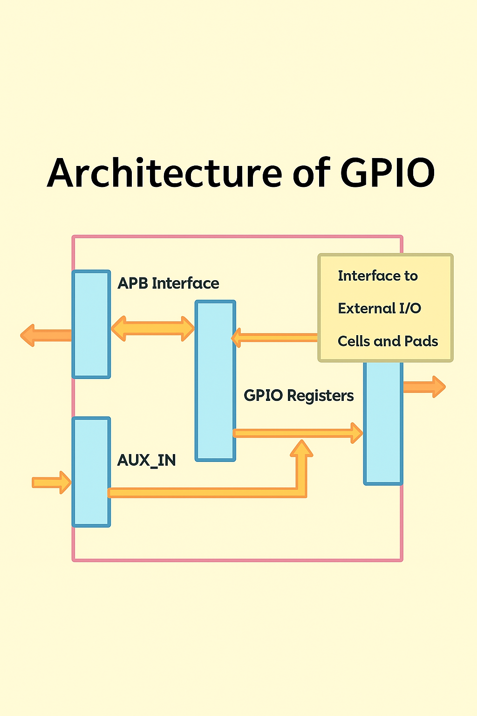
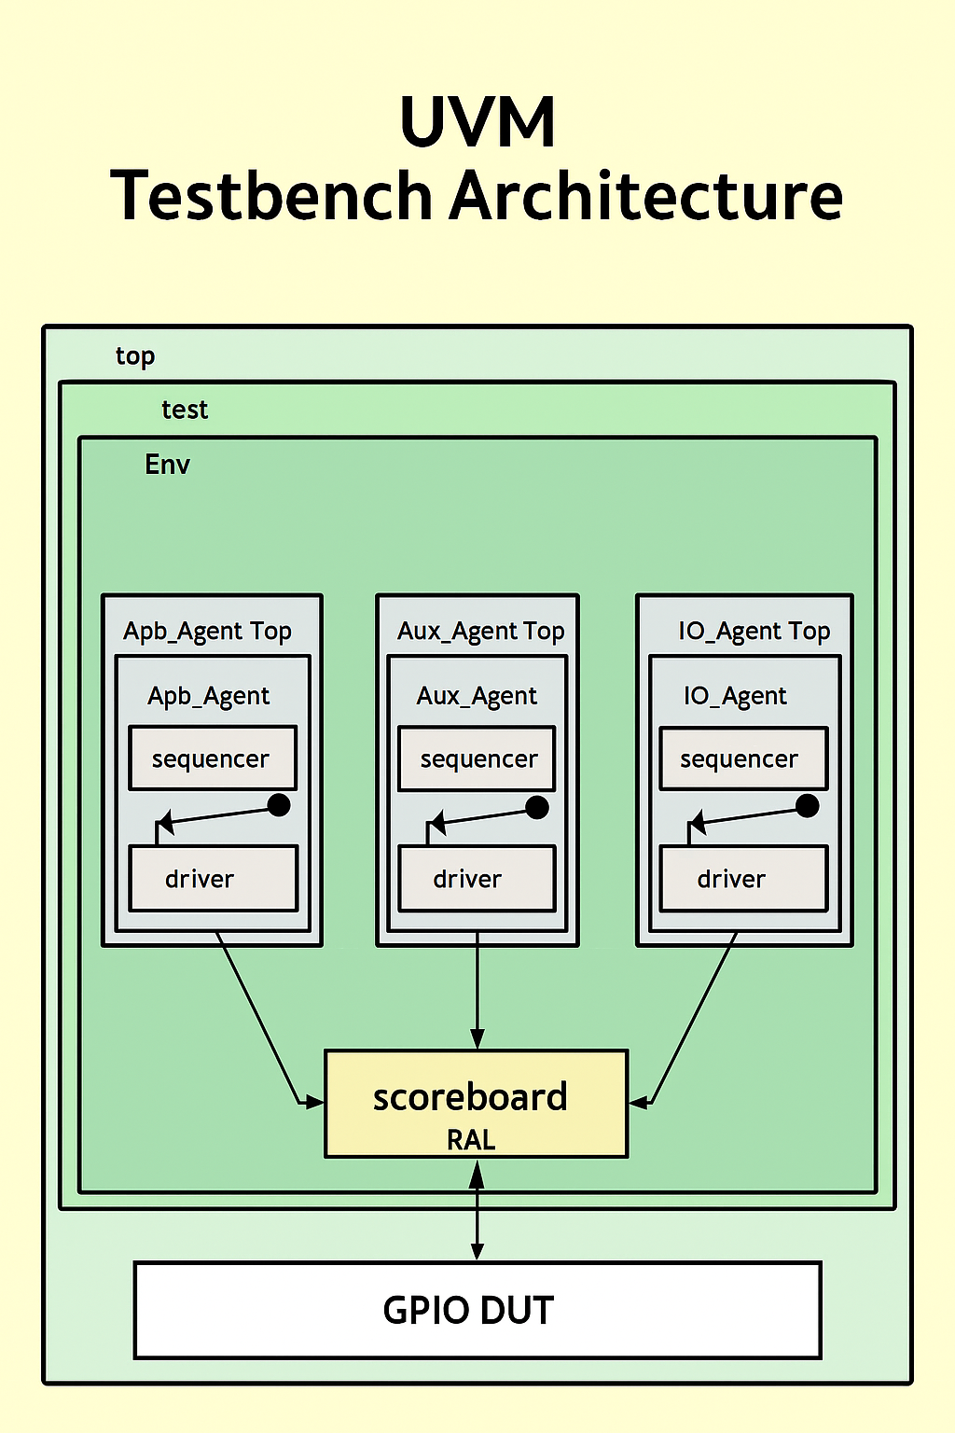
BLOCK DIAGRAM AND TESTBENCH ARCHITECTURE

Slide 6
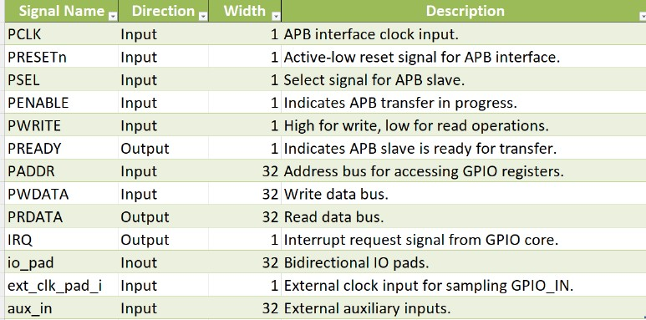
APB BASED GPIO SIGNALS

Slide 7
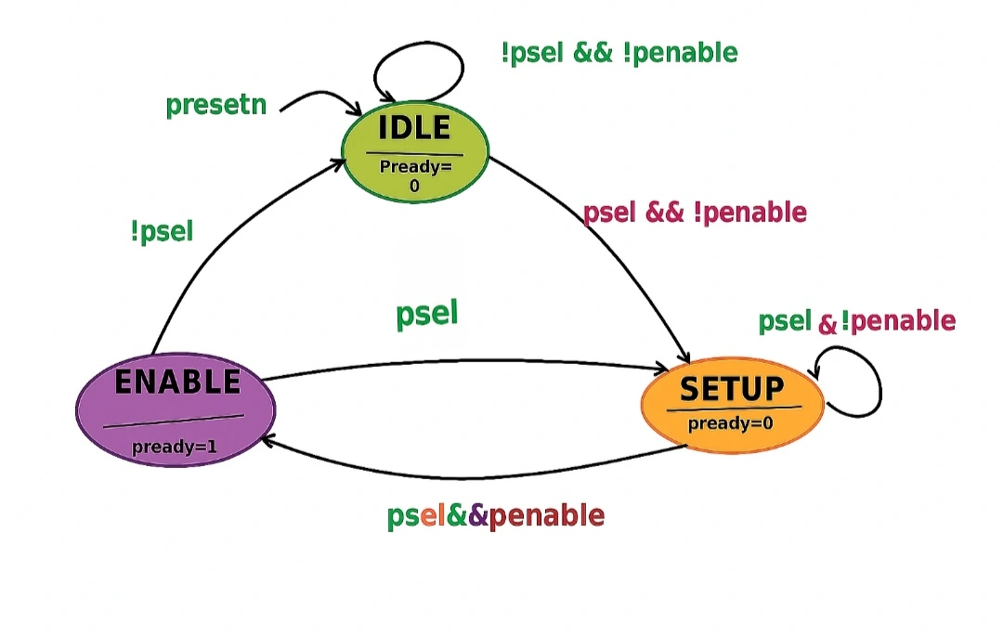
APB AND IT’S STATE DIAGRAM
Simple & Low Power APB is a simple, low-power interface ideal for connecting peripheral devices.
Two-Phase Transfer Uses setup and enable phases for clear, controlled data transfers.
Synchronous & Single-Master Operates synchronously with no arbitration needed.
Bridge Compatible Easily connects with AHB/AXI via a bridge for slower peripheral access.

Slide 8
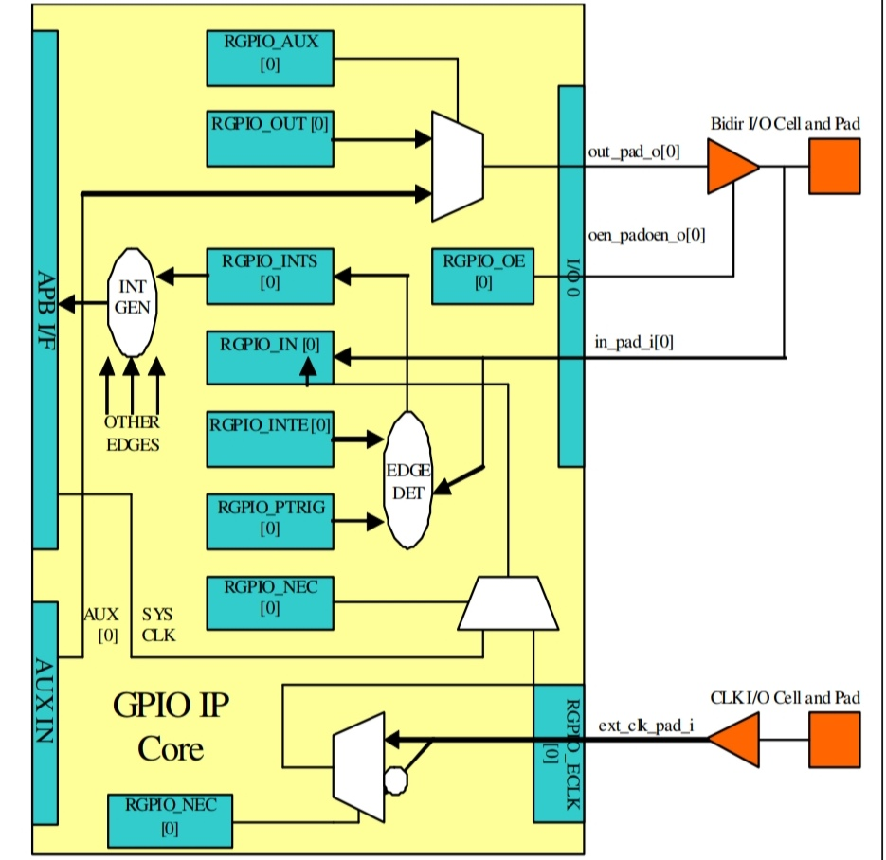
BLOCK DIAGRAM OF GPIO LOGIC
General Purpose I/O GPIO pins can be configured as either input or output.
Flexible Control Used to control LEDs, switches, or read sensor signals.
Software Programmable Direction and value can be controlled via software registers.
Interrupt Support Can trigger interrupts on input signal changes.

Slide 9
SCOREBOARD DESCRIPTION FOR APB-BASED GPIO PROJECT
Reference Model Integration
Scoreboard uses the RAL model to fetch expected register values and compare them with DUT outputs for read/write APB transactions.
Data Comparison Logic
It receives transactions from the monitor and verifies actual DUT behavior by comparing against RAL mirror values, ensuring functional correctness.
Error Reporting
On mismatch between observed and expected values, the scoreboard logs detailed errors, helping in pinpointing bugs and protocol violations.
Coverage and Debug Aid
It supports functional coverage collection and acts as a debug reference point for verifying register-level correctness over simulation cycles
5.UVM-RAL Synchronization
Synchronizes register write/read updates via RAL APIs enabling automated and reliable DUT tracking.

Slide 10
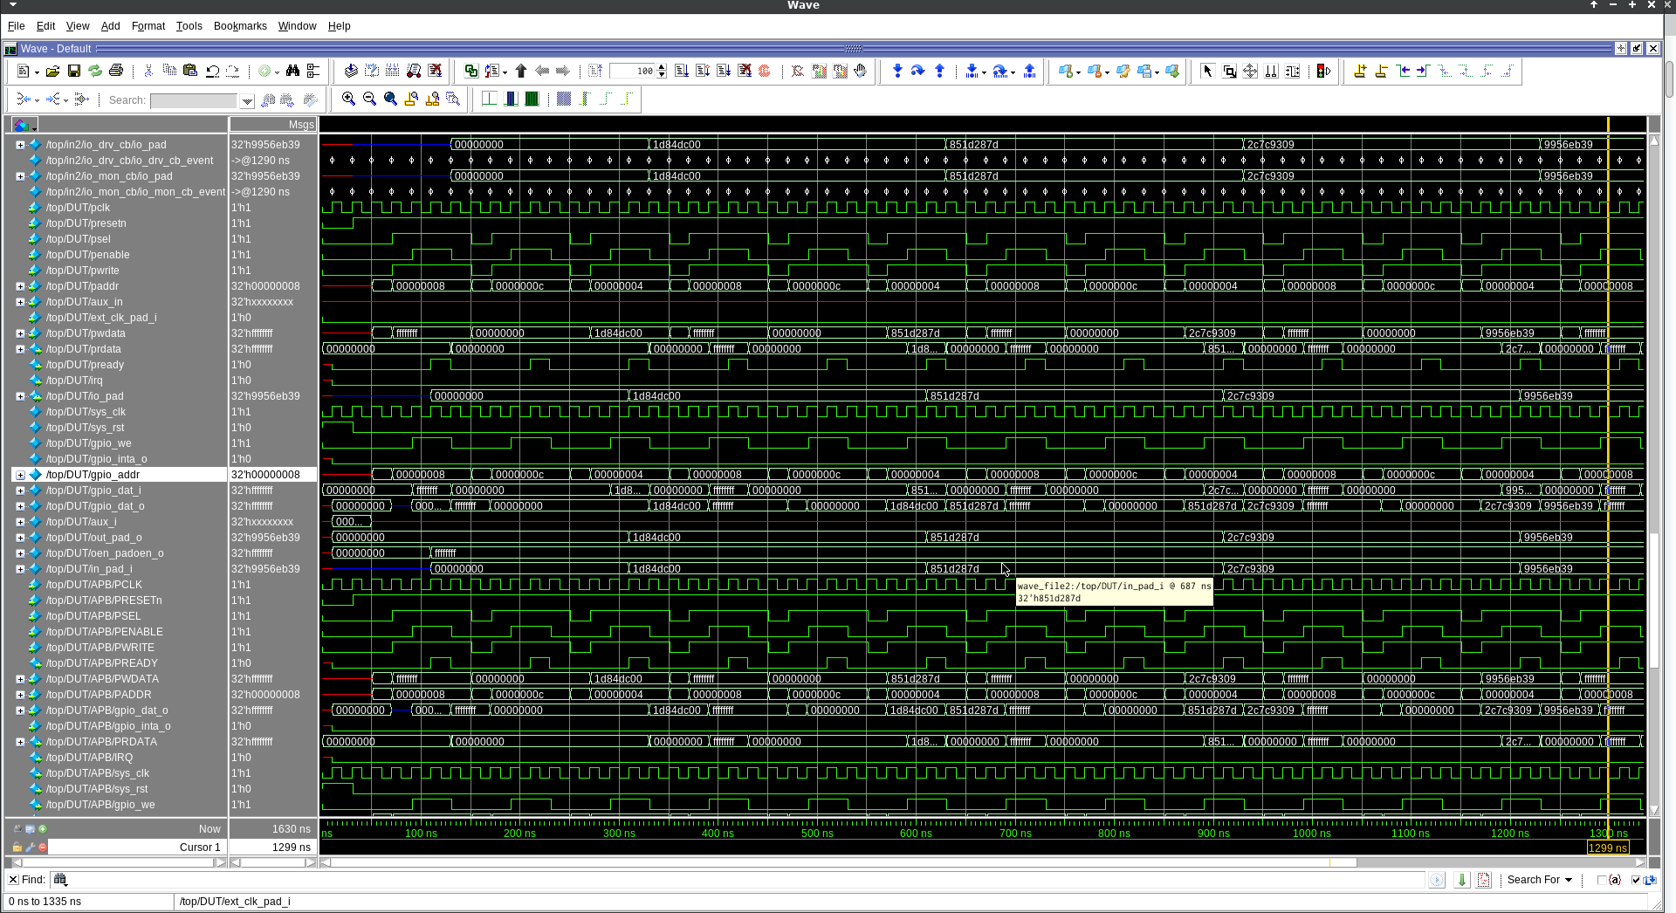
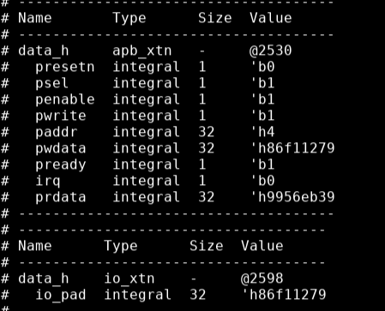
General-Purpose I/O as Polled Input

Slide 11
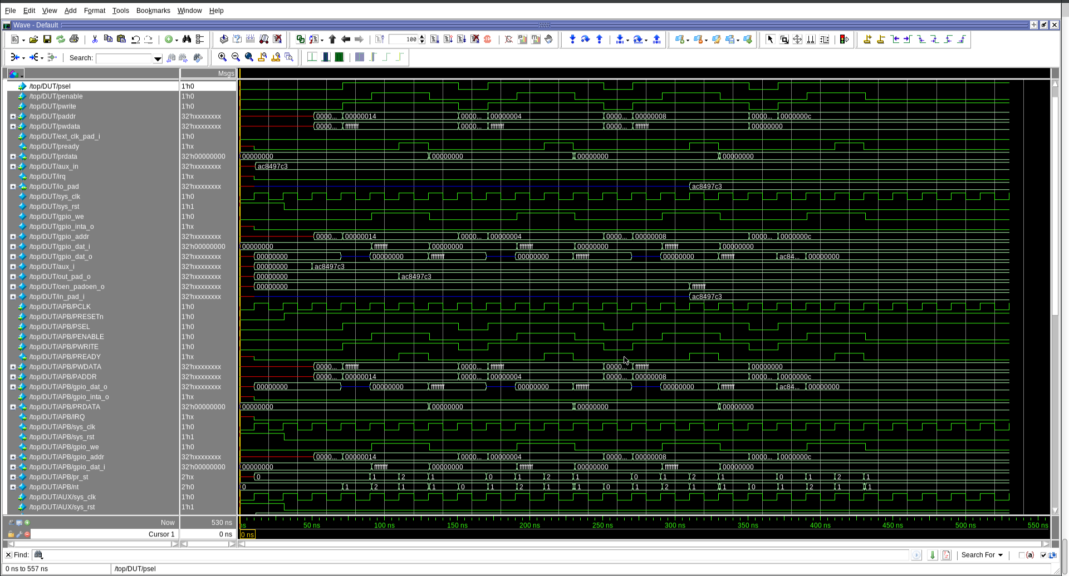
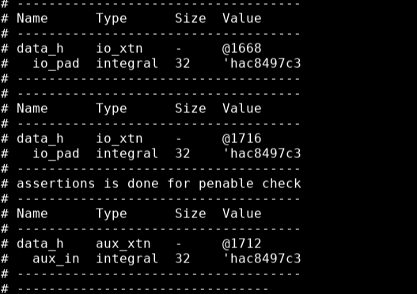
General-Purpose I/O driven by Auxiliary Input

Slide 12
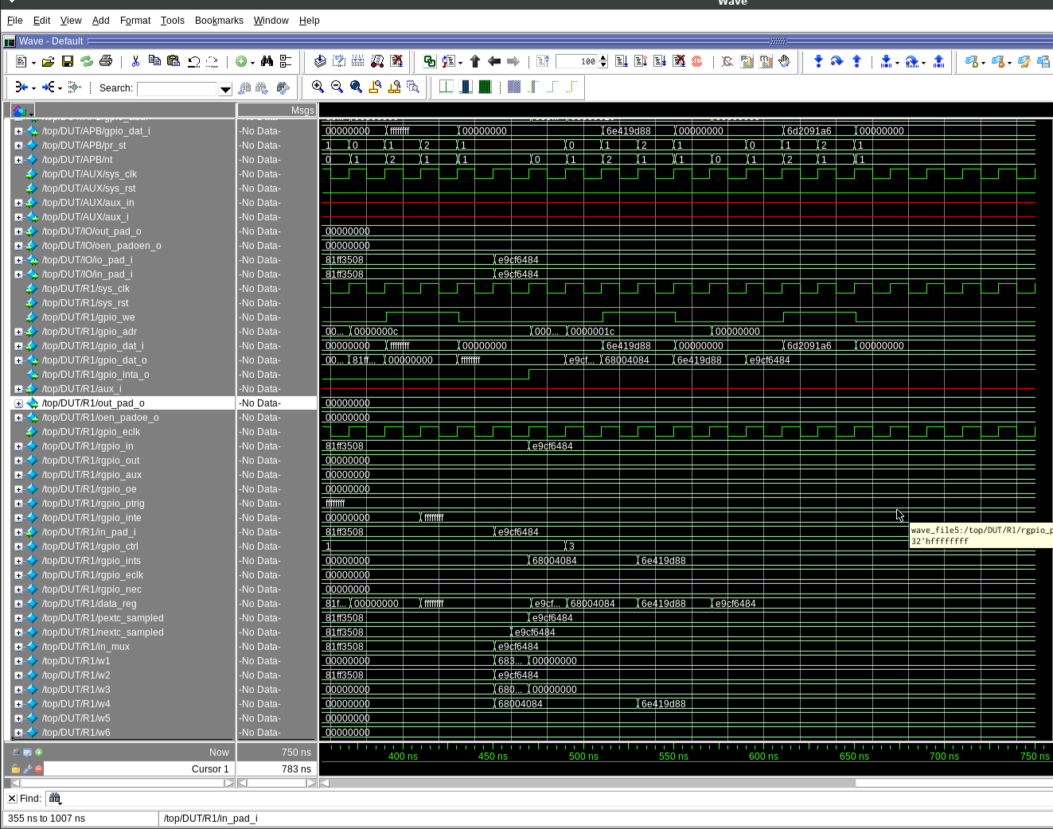
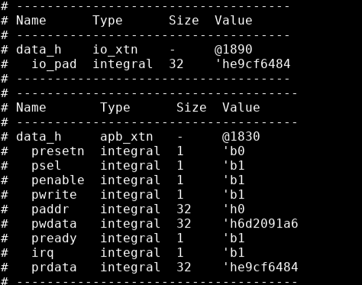
General-Purpose I/O as Input in Interrupt Mode

Slide 13
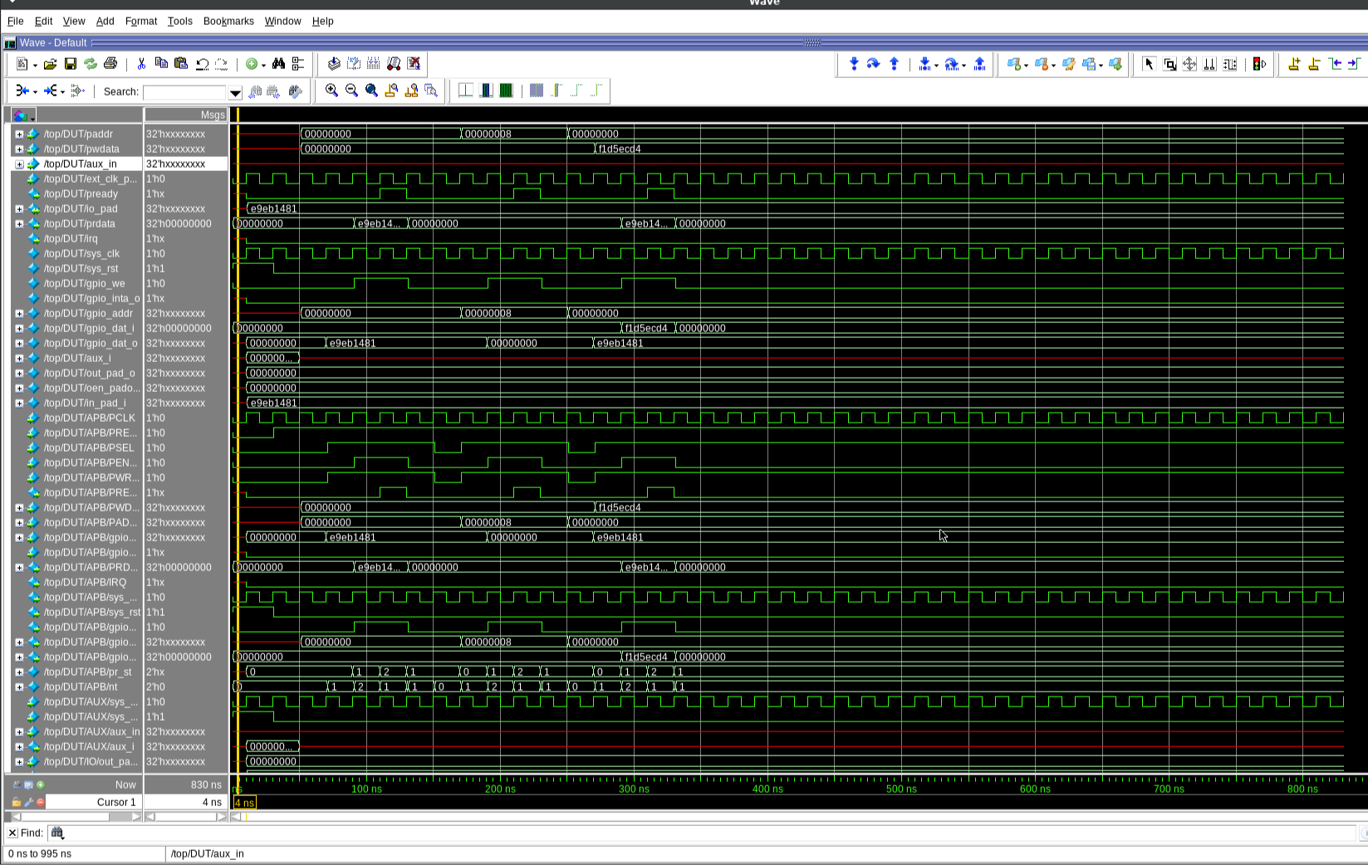
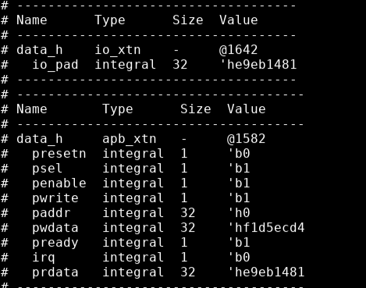
General-Purpose I/O as Output

Slide 14
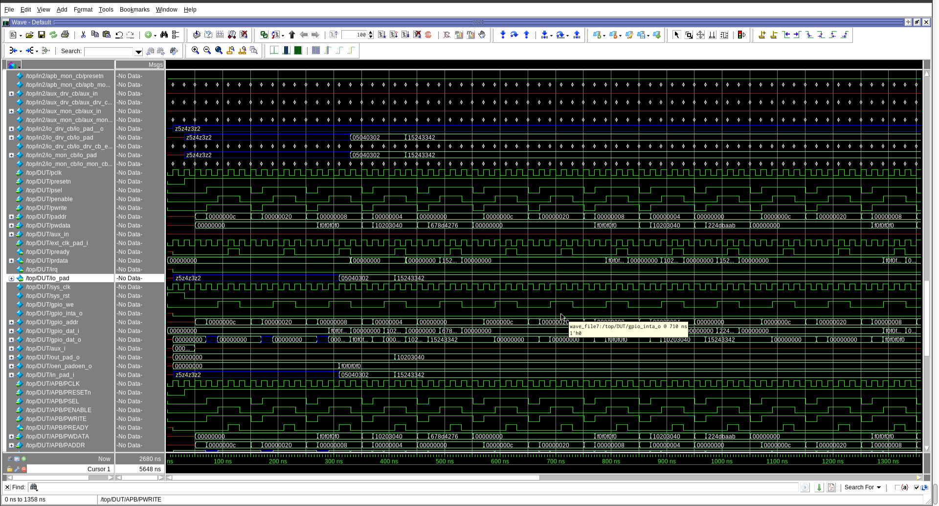
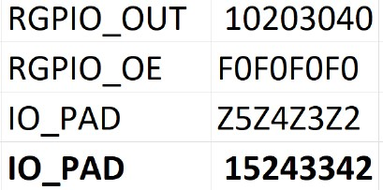
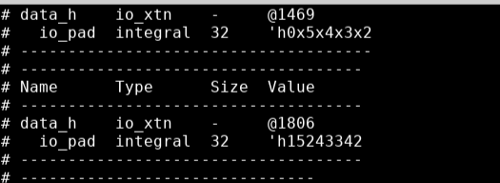
General-Purpose I/O as Input in Interrupt Mode

Slide 15
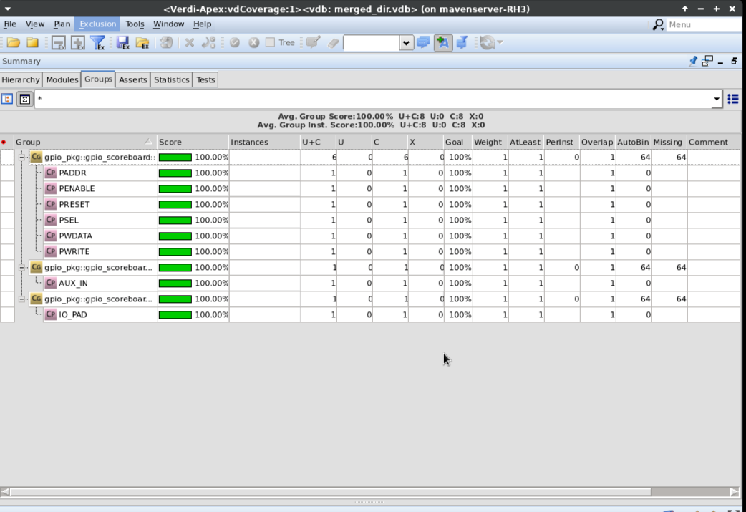
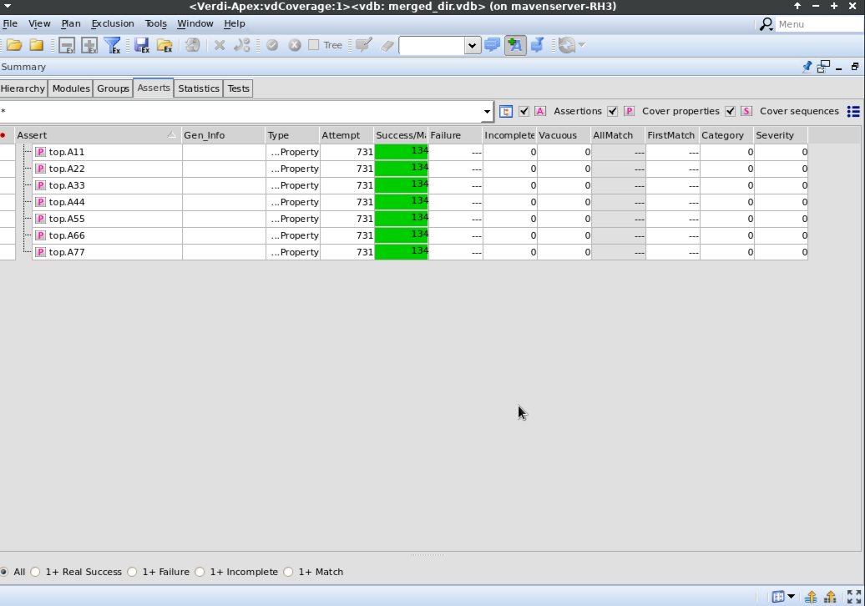
FUNCTIONAL COVERAGE AND ASSERTIONS REPORT

Slide 16
TAKEAWAYS & CHALLENGES
Hands-on APB Protocol Understanding – Learned how APB signals work and how to design for low-bandwidth communication.
Built UVM-Based Testbench – Gained experience in using UVM for structured, reusable verification.
Faced Signal Timing Issues – Synchronizing PSEL, PENABLE, and PREADY correctly
Used RAL and Assertions – Applied Register Abstraction Layer a SystemVerilog Assertions to improve test quality.
Debugging Scoreboard Mismatches – Identifying and fixing mismatche between expected and actual outputs was time-consuming.
Improved GPIO Design Knowledge – Understood input/output control, register behavior, and how to simulate real-time GPIO operations

Slide 17
CONCLUSION
Developed a UVM-based testbench with modular agents for APB, AUX, and IO interfaces.
Used Assertions (SVA) to check protocol correctness and catch timing violations.
Implemented Register Abstraction Layer (RAL) for register-level access and automation.
Achieved 100% functional and code coverage using Questasim simulator.
Scoreboard and monitors ensured accurate comparison of AUX and IO agent outputs.
Ensured reusability, scalability, and protocol compliance across the verification environment

Slide 18


